Slide 1
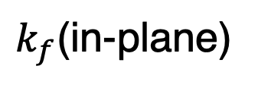
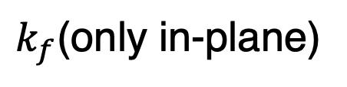
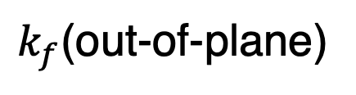
(a)
(b)
Sample
Neutron spin
Cu₂MnAl
³He-NSF
↑↓
↑
↑↓
$k_{f}$(only in-plane)
$k_{f}$(in-plane)
↑
$k_{f}$(out-of-plane)
to point detector
2D detector

Slide 2
(a)
(b)
Sample
Neutron spin
Cu₂MnAl
³He-NSF
↑↓
↑
↑↓
$k_{f}$(only in-plane)
$k_{f}$(in-plane)
↑
$k_{f}$(out-of-plane)
to point detector
2D detector

Slide 3

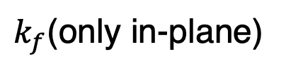


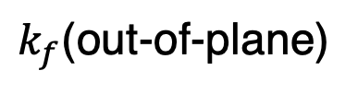
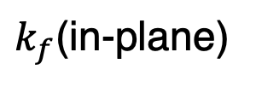
(a)
Cu₂MnAl (Polarizer)
Spin flipper
off : ↑
on : ↓
Incident neutrons
Cu₂MnAl (Analyzer)
↑↓
↑
Sample
↑↓
Neutron spin
$$k_{i}$$
↑
$$Q$$
$k_{f}$(only in-plane)
point detector
(b)
³He-NSF
(³He polarity can be flipped)
↑
↑↓
↑
↑↓
$k_{f}$(in-plane)
$$Q$$
$k_{f}$(out-of-plane)
2D detector

Slide 4
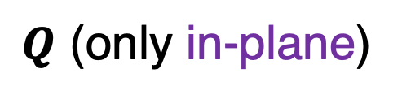
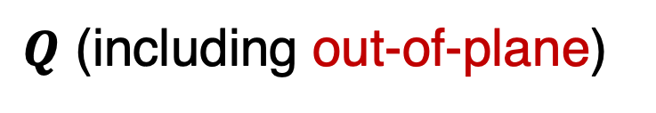
(a)
Cu₂MnAl (Polarizer)
Incident
neutrons
Sample
Cu₂MnAl (Analyzer)
↑↓
↑
↑↓
Neutron spin
Spin flipper
off : ↑
on : ↓
↑
$Q$ (only in-plane)
point detector
(b)
³He-NSF (Analyzer)
↑
↑↓
↑
↑↓
$Q$ (including out-of-plane)
2D detector

Slide 5
(a)
Cu₂MnAl (Polarizer)
Cu₂MnAl (Analyzer)
↑↓
↑
Sample
Incident
neutrons
↑↓
↑
Neutron spin
Spin flipper
off : ↑
on : ↓
point detector
$Q$ (only in-plane)
(b)
³He-NSF (Analyzer)
↑
↑↓
↑
↑↓
$Q$ (including out-of-plane)
2D detector

Slide 6
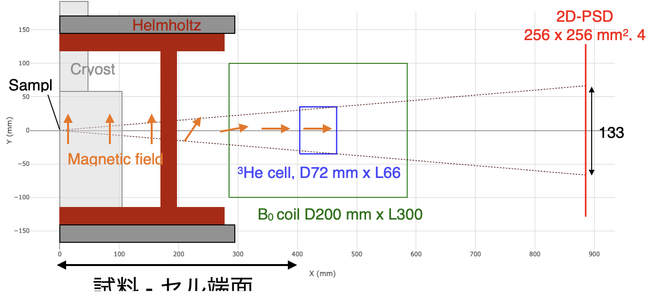

Slide 7
ω rotation
Helmholtz coil
Cryostat
Neutron Area detector
³He NSF coil
Neutron guide tube
Polarization analysis region
Magnetic field direction
RF coil
³He cell
Neutron beam path
Sample
Pickup coil

Slide 8
ω rotation
Helmholtz coil
Cryostat
Neutron Area detector
³He NSF coil
Neutron guide tube
Polarization analysis region
Magnetic field direction
RF coil
³He cell
Neutron beam path
Sample
Pickup coil

Slide 9
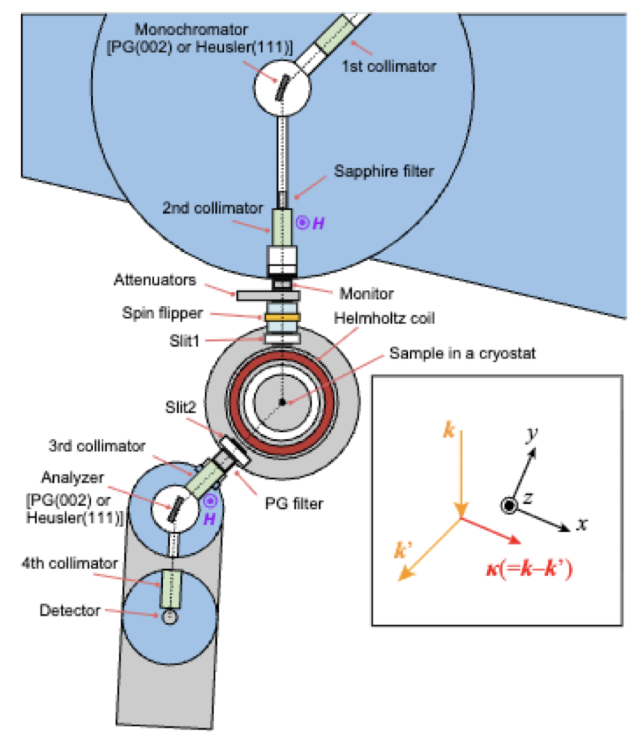
Beam stopper
Beam stopper

Slide 10
Incident neutron beam
(polarized by Cu₂MnAl crystal)
Top view
Sample
Top view
Beam stopper
Neutron Area detector
³He NSF coil
RF coil
Polarization analysis region
Sample
³He cell
Incident neutron
(polarized by Cu₂MnAl)
Neutron guide tube
Side view
ω rotation
Helmholtz coil
Cryostat
Magnetic field direction
Pickup coil

Slide 11


Incident neutron beam
(polarized by Cu₂MnAl crystal)
Top view
Top view
Beam stopper
Sample
2D detector
$$c^{∗}$$
$$a^{∗}$$
Sample
32°
³He cell
Neutron guide tube
Incident neutron
RF coil
³He NSF coil
Side view
ω rotation
Helmholtz coil
Refrigerator
±4.0°
Magnetic field direction
Pickup coil
430 mm
915 mm

Slide 12
Neutron Area detector
³He NSF coil
Neutron guide tube
Polarization analysis region
RF coil
³He cell

Slide 13
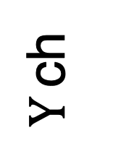
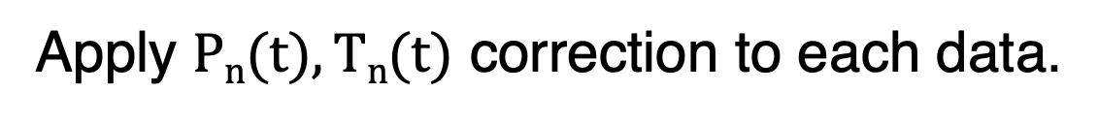
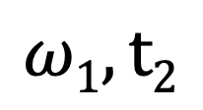
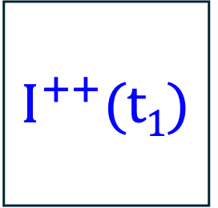
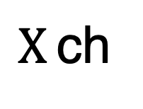

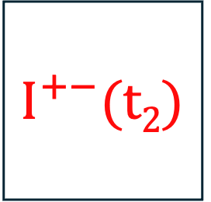
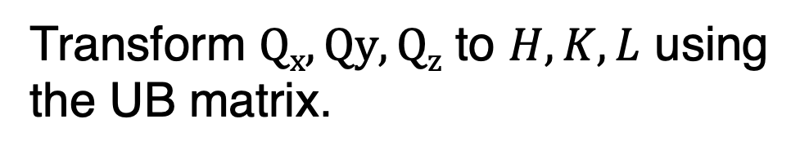
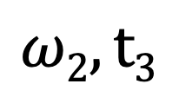
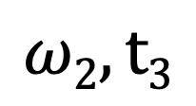

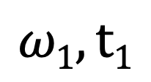
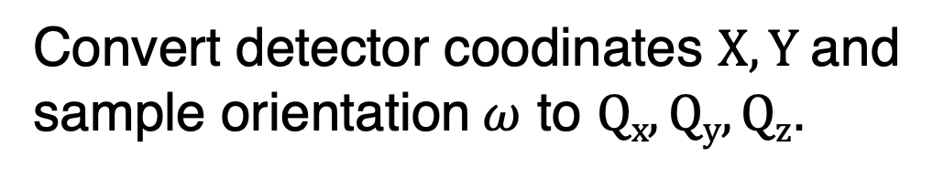
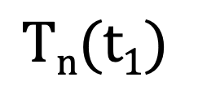
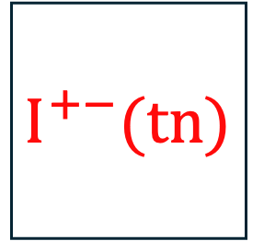
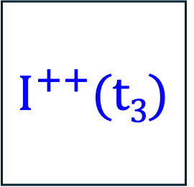
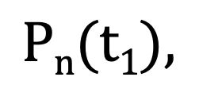
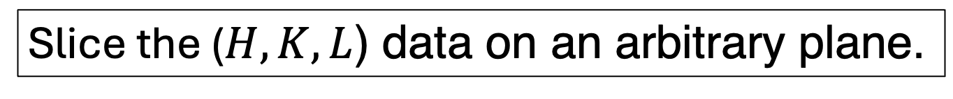
Data set
$$ω1, t1$$
$$ω1, t2$$
$$ω2, t3$$
$$ω2, t3$$
$$I^{++}(t1)$$
$$I^{+−}(t2)$$
$$I^{++}(t3)$$
$$I^{+−}(tn)$$
$Y$ ch
...
$X$ ch
$$Pn(t1),$$
$$Pn(tn)$$
$$Tn(t1)$$
$$Tn(tn)$$
Apply $Pn(t), Tn(t)$ correction to each data.
Convert detector coodinates $X, Y$and
sample orientation $ω$ to $Qx, Qy, Qz$.
Transform $Qx, Qy, Qz$ to $H, K, L$ using
the UB matrix.
Slice the ($H,K,L$) data on an arbitrary plane.

Slide 14
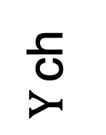
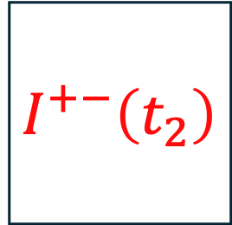
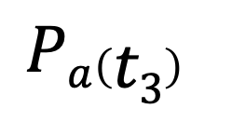
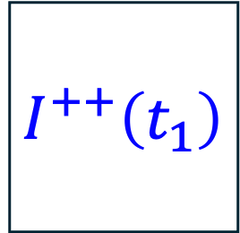
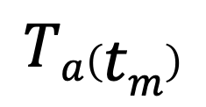
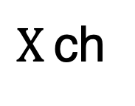
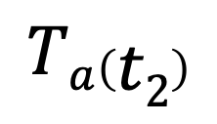


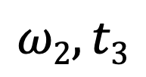
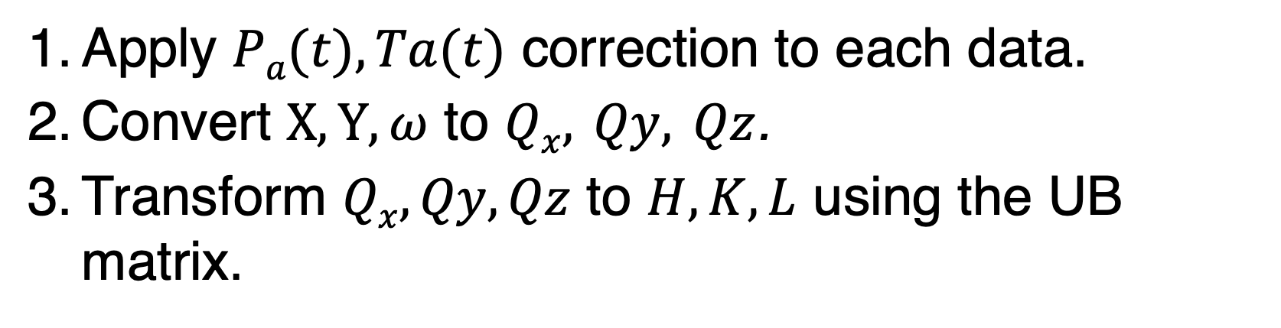
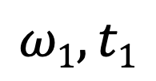
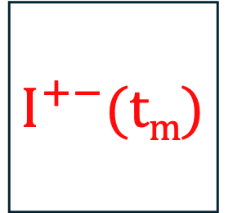

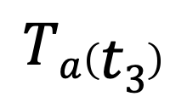
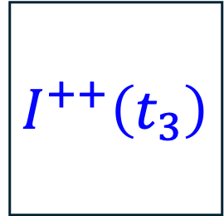
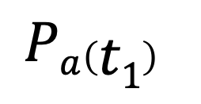
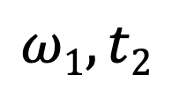

Data Set
$$ω1, t1$$
$$ω1, t2$$
$$ω2, t3$$
$$ωn, tm$$
$$I^{++}\left(t_{1}\right)$$
$$I^{+−}\left(t_{2}\right)$$
$$I^{++}\left(t_{3}\right)$$
$$I^{+−}(tm)$$
$Y$ ch
...
$X$ ch
$$Pa\left(t1\right)$$
$$Pa\left(t2\right)$$
$$Pa\left(t3\right)$$
...
$$Pa\left(tm\right)$$
$$Ta\left(t1\right)$$
$$Ta\left(t2\right)$$
$$Ta\left(t3\right)$$
$$Ta\left(tm\right)$$
Data Analysis
Apply $Pa(t), Ta(t)$ correction to each data.
Convert $X, Y, ω$ to $Qx, Qy, Qz$.
Transform $Qx, Qy, Qz$ to $H, K, L$ using the UB matrix.
Slice the ($H,K,L$) data on an arbitrary plane.

Slide 15
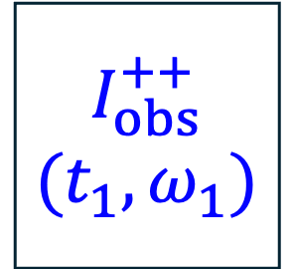
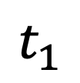
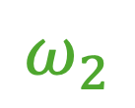
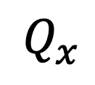

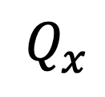























³He spin flip
(AFP-NMR)
$$Q_{z}$$
flip
flip
$$n$$
$$I_{obs}^{++}$$
$$(t_{1},ω_{1})$$
$$I_{obs}^{++}$$
$$(t_{3},ω_{2})$$
$Y$ ch
$$1$$
$$I_{corr}^{++}$$
$$Q_{y}$$
$X$ ch
$$Q_{x}$$
$$I_{obs}^{+−}$$
$$\left(t_{2},ω_{1}\right)$$
$$I_{obs}^{+−}$$
$$\left(t_{4},ω_{2}\right)$$
Time Dependent Correction
Map to
Reciprocal
Space
$$I_{corr}^{++}\left(ω_{n}\right)$$
$$I_{corr}^{+−}\left(Q_{x}, Q_{y}, Q_{z}\right)$$
$$n$$
$$Q_{z}$$
$$P_{a}(t)$$
$$P_{a},T_{a}$$
$$1$$
$$I_{corr}^{+−}$$
$$Q_{y}$$
$$T_{a}(t)$$
$$Q_{x}$$
$$t_{1}$$
$$t_{2}$$
$$t_{3}$$
$$t_{4}$$
Time
$$ω_{1}$$
$$ω_{2}$$
$$I_{corr}^{+−} \left(ω_{n}\right)$$
$$I_{corr}^{+−}\left(Q_{x}, Q_{y}, Q_{z}\right)$$

Slide 16















³He spin flip
(AFP-NMR)
flip
flip
$$n$$
Magnetic reflections
$$Q_{z}$$
$$I_{obs}^{++}(t_{1},$$
$$ω_{1},x_{i}, y_{j})$$
$$I_{obs}^{++}(t_{3},$$
$$ω_{2},x_{i}, y_{j})$$
$Y$ ch
$$1$$
$$I^{++}(ω_{1},$$
$$x_{i}, y_{j})$$
$X$ ch
$$Q_{y}$$
$$I_{obs}^{+−}(t_{2},$$
$$ω_{1},x_{i}, y_{j})$$
$$I_{obs}^{+−}(t_{4},$$
$$ω_{2},x_{i}, y_{j})$$
$$Q_{x}$$
Time Dependent Correction
Map to
Reciprocal
Space
$$I^{++}\left(ω_{n},x_{i},y_{j}\right)$$
$$I^{++}\left(Q_{x}, Q_{y}, Q_{z}\right)$$
$$n$$
$$P_{a}(t)$$
$$Q_{z}$$
$$P_{a},T_{a}$$
$$1$$
$$I^{+−}(ω_{1},$$
$$x_{i}, y_{j})$$
$$T_{a}(t)$$
$$Q_{x}$$
$$Q_{y}$$
$$t_{1}$$
$$t_{2}$$
$$t_{3}$$
$$t_{4}$$
Time
$$ω_{1}$$
$$ω_{2}$$
$$I^{+−}\left(ω_{n},x_{i},y_{j}\right)$$
$$I^{+−}\left(Q_{x}, Q_{y}, Q_{z}\right)$$

Slide 17
Neutron polarization
³He polarization
Neutron transmission

Slide 18
Neutron polarization
Neutron polarization
³He polarization
³He polarization
Neutron transmission
Neutron transmission

Slide 19
Neutron polarization
³He polarization
Neutron transmission

Slide 21


















$$×Σ^{++}$$
$$×T_{a}^{+}p_{a}^{+}$$
$$N_{+}T_{p}^{+}p_{p}^{+}Σ^{++}T_{a}^{+}p_{a}^{+}$$
$$N_{+}$$
$$×T_{p}^{}p_{p}^{}$$
$$×Σ^{+−}$$
$$×T_{a}^{+}{(1−p}_{a}^{+})$$
$$N_{+}T_{p}^{+}p_{p}^{+}Σ^{+−}T_{a}^{+}(1−p_{a}^{+})$$
$$I^{++}$$
$$×Σ^{−+}$$
$$×T_{a}^{+}p_{a}^{+}$$
$$N_{−}T_{p}^{+}{(1−p}_{p}^{+})Σ^{−+}T_{a}^{+}p_{a}^{+}$$
$$N_{−}$$
$$×T_{p}^{+}{(1−p}_{p}^{+})$$
$$×Σ^{−−}$$
$$×T_{a}^{+}{(1−p}_{a}^{+})$$
$$N_{−}T_{p}^{+}{(1−p}_{p}^{+})Σ^{−−}T_{a}^{+}(1−p_{a}^{+})$$
Polarizer
Cu₂MnAl
+
Sample
Analyzer
ex-situ ³He-NSF
+ (or $−$)
Detector

Slide 22












$$×Σ^{++}$$
$$×T_{a}p_{a}$$
$$N_{0}T_{p}p_{p}Σ^{++}T_{a}p_{a}$$
$$×T_{p}p_{p}$$
$$×Σ^{+−}$$
$$×T_{a}{(1−p}_{a})$$
$$N_{0}T_{p}p_{p}Σ^{+−}T_{a} (1−p_{a})$$
$$N_{0}$$
$$I^{++}$$
$$×Σ^{−+}$$
$$×T_{a}p_{a}$$
$$N_{0}T_{p}\left(1−p_{p}\right)Σ^{−+}T_{a}p_{a}$$
$$×T_{p}(1−p_{p})$$
$$×Σ^{−−}$$
$$×T_{a}{(1−p}_{a})$$
$$N_{0}T_{p}\left(1−p_{p}\right)Σ^{−−}T_{a} (1−p_{a})$$
Polarizer
Cu₂MnAl
+
Sample
Analyzer
ex-situ ³He-NSF
+ (or $−$)
Detector

Slide 23












$$×I^{++}$$
$$×T_{a}p_{a}$$
$$×T_{p}p_{p}$$
$$×I^{+−}$$
$$×T_{a}{(1−p}_{a})$$
$$N_{0}$$
$$I_{obs}^{++}$$
$$×I^{−+}$$
$$×T_{a}p_{a}$$
$$×T_{p}(1−p_{p})$$
$$×I^{−−}$$
$$×T_{a}{(1−p}_{a})$$
Polarizer
Heusler
+
Sample
Analyzer
ex-situ ³He-NSF
+
Detector

Slide 24













$$×I^{++}$$
$$×{2T}_{a}p_{a}^{+}$$
$$N^{+}$$
$$×2T_{p}p_{p}^{+}$$
$$×I^{+−}$$
$$×{2T}_{a}(1−p_{a}^{+})$$
$$I_{obs}^{++}$$
$$×I^{−+}$$
$$×{2T}_{a}p_{a}^{+}$$
$$N^{−}$$
$$×{2T}_{p}(1−p_{p}^{+})$$
$$×I^{−−}$$
$$×2T_{a}(1−p_{a}^{+})$$
Polarizer
Heusler
+
Sample
Analyzer
ex-situ ³He-NSF
+
Detector

Slide 25






$$×I^{++}$$
$$×{2T}_{a}p_{a}$$
$$N^{+}$$
$$×2T_{p}p_{a}$$
$$×I^{+−}$$
$$×{2T}_{a}(1−p_{a})$$
$$I_{obs}^{++}$$
$$×I^{−+}$$
$$×{2T}_{a}p_{a}$$
$$N^{−}$$
$$×{2T}_{p}(1−p_{a})$$
$$×I^{−−}$$
$$×2T_{a}(1−p_{a})$$
Polarizer
Heusler
+
Sample
Analyzer
ex-situ ³He-NSF
+
Detector

Slide 26








$$×I^{++}$$
$$×T_{a}(1+P_{a})$$
$$N_{+}$$
$$×T_{p}(1+P_{p})$$
$$×I^{+−}$$
$$×T_{a}{(1−P}_{a})$$
$$I_{obs}^{++}$$
$$×I^{−+}$$
$$×T_{a}(1+P_{a})$$
$$N_{−}$$
$$×T_{p}(1−P_{p})$$
$$×I^{−−}$$
$$×T_{a}{(1−P}_{a})$$
Polarizer
Heusler
+
Sample
Analyzer
ex-situ ³He-NSF
+
Detector

Slide 27








$$×I^{++}$$
$$×T_{p}^{+}$$
$$N^{+}$$
$$×T_{p}^{+}$$
$$×I^{+−}$$
$$×T_{p}^{−}$$
$$I_{obs}^{++}$$
$$×I^{−+}$$
$$×T_{p}^{+}$$
$$N^{−}$$
$$×T_{p}^{−}$$
$$×I^{−−}$$
$$×T_{p}^{−}$$
Polarizer
Heusler
+
Sample
Analyzer
ex-situ ³He-NSF
+
Detector

Slide 29
1Å
3Å
(a)
(b)
#Frame2-3
Sample position
from spallation source
Collinear structure
Frame
#1
#2
#3
#4
#5
#6
#7
Phase transition field
(c)
#Frame5-6
Magnetic field of
long pulse magnet
Non-collinear structure
Kicker signal

Slide 31

Sliced plane (a)
Measured Q region
Sliced plane (b)
Reciprocal
lattice points

Slide 32



Reciprocal
lattice points
Two-dimensional
detector
Measurable
Q region
Sample
$$k_{f}$$
$$Q$$
Polarization analysis
region
³He neutron spin filter
(Spin analyzer)
$$k_{i}$$
Incident polarized neutron

Slide 33
(a) Unpolarized
(b) Polarized
Intensity (a.u.)
Intensity (a.u.)

Slide 34
(c) Unpolarized
(d) Polarized
(e) Line cut
(e)
(f) Line cut
(f)

Slide 35
Sliced plane (a)
Measured Q region
Sliced plane (b)
Intensity (a.u.)
Reciprocal
lattice points

Slide 37


Intensity (a.u.)
Intensity (a.u.)

Slide 38
(a) Raw data
(b) Corrected data

Slide 39
(a) Raw data
(b) Corrected data

Slide 40


(a) Raw data
(b) Corrected data
$$ℐ_{obs}^{++}$$
$$ℐ_{obs}^{+−}$$
(H,0,2) (r.l.u.)

Slide 41


(a) Non-spin flip ($I^{++}$)
(b) Spin flip ($I^{+−}$)
(c)

Slide 42


(a) Non-spin flip ($I^{++}$)
(b) Spin flip ($I^{+−}$)
(c) X-direction line profile (dased region in (a), (b))
Integrated intensity (y pixels 27-35) (a.u.)

Slide 43
(a)
(b)
(c)
Integrated intensity (y pixels 27-35) (a.u.)

Slide 44

(a)
(b)
(c)
Integrated intensity (y pixels 27-35) (a.u.)

Slide 45



(a) $\overline{1}02$ reflection in $I_{obs}^{++}$
(b) $\overline{1}02$ reflection in $I_{obs}^{+−}$
(c) X projection of the dashed line region in (a) and (b))

Slide 46


(a) $\overline{1}02$ reflection in $I_{obs}^{++}$
(b) $\overline{1}02$ reflection in $I_{obs}^{+−}$
(c) X projection of the dashed line region in (a) and (b))

Slide 47
(a) $\overline{1}02$ reflection in $I_{obs}^{++}$
(b) $\overline{1}02$ reflection in $I_{obs}^{+−}$
(c) X projection of the dashed line region in (a) and (b))

Slide 48
(a) $\overline{1}02$ reflection in $I_{obs}^{++}$
(b) $\overline{1}02$ reflection in $I_{obs}^{+−}$
(c) X projection of the dashed line region in (a) and (b))

Slide 49


(a) $I_{obs}^{++}$ map
(b) $I_{obs}^{+−}$ map
(d) X projection of the dashed line region in (a) and (b))

Slide 50







(0,-K+2K,0) || z
Sliced Region (b),(d)
Sliced Region (c),(e)
$$H=\overline{1}$$
(-H,0,0) || -x
$$q_{3}$$
$$q_{1}$$
$$\overline{1}02$$
$$L=1.5$$
$$q_{2}$$
(0,0,L) || y

Slide 51





(0,-H+2K,0) || z
(c),(e)
(b),(d)
(-H-K/2,0,0) || -x
$$q_{3}$$
$$q_{1}$$
$$\overline{1}02$$
$$L=1.5$$
$$q_{2}$$
(0,0,L) || y

Slide 52





(c)
(f)
(a)
(f)
(-K/2,K,0) || z
(g)
(c),(e)
(b),(d)
(-H,0,0) || -x
$$q_{3}$$
(g)
$$q_{1}$$
(e)
$$\overline{1}02$$
$$L=1.5$$
$$q_{2}$$
(0,0,L) || y

Slide 53








(a)
(b)
(-K/2,K,0) || z
(c)
(b)
$$q_{1}$$
$$q_{3}$$
(-H,0,0) || -x
$$q_{1}$$
$$q_{3}$$
(c)
$$\overline{1}02$$
$$q_{3}$$
$$q_{2}$$
$$q_{1}$$
$$L=1.5$$
(0,0,L) || y
$$q_{2}$$

Slide 54






(a)
(b)
(c)
(f)
(-K/2,K,0) || z
$$q_{3}$$
$$q_{1}$$
(b), (c)
$$q_{2}$$
(d), (e)
(-H,0,0) || -x
$$q_{3}$$
$$q_{1}$$
(d)
(e)
(g)
(f)
$$\overline{1}02$$
(g)
$$q_{2}$$
(0,0,L) || y
$$q_{3}$$
$$q_{1}$$

Slide 55





(a)
(b)
(c)
(f)
(-K/2,K,0) || z
$$q_{3}$$
$$q_{1}$$
(b), (c)
$$q_{2}$$
(d), (e)
(-H,0,0) || -x
$$q_{3}$$
$$q_{1}$$
(d)
(e)
(g)
(f)
$$\overline{1}02$$
(g)
$$q_{2}$$
(0,0,L) || y
$$q_{1}$$
$$q_{3}, q_{2}$$

Slide 56






(a)
(b)
(c)
(f)
(K/2,-K,0) || z
$$q_{3}$$
$$q_{1}$$
(f)
(b), (c)
(-K/2, K, 1.5) (r.l.u.)
(-K/2, K, 1.5) (r.l.u.)
(g)
Intensity (arb.unit)
(d), (e)
(-H,0,0) || -x
$$q_{2}$$
$$q_{2}$$
$$q_{1}$$
(H,0,1.5) (r.l.u.)
(H,0,1.5) (r.l.u.)
(H,0,1.5) (r.l.u.)
(d)
(e)
(g)
$$\overline{1}02$$
(g)
$$q_{3}$$
(0,0,L) (r.l.u.)
$$q_{3}, q_{2}$$
L (r.l.u.)
$$q_{1}$$
Intensity (arb.unit)
(0,0,L) || y
(f)
(H,0,0) (r.l.u.)
(H,0,0) (r.l.u.)
(H,0,1.5) (r.l.u.)

Slide 57





(a)
(b)
(c)
(f)
(K/2,-K,0) || z
$$q_{3}$$
(f)
(b), (c)
(-K/2, K, 1.5) (r.l.u.)
(-K/2, K, 1.5) (r.l.u.)
(g)
Intensity (arb.unit)
$$q_{1}$$
(d), (e)
$$q_{2}$$
(-H,0,0) || -x
$$q_{2}$$
$$q_{1}$$
(H,0,1.5) (r.l.u.)
(H,0,1.5) (r.l.u.)
(H,0,1.5) (r.l.u.)
(d)
(e)
(g)
$$\overline{1}02$$
a*
c*
(g)
$$q_{3}$$
(0,0,L) (r.l.u.)
$$q_{3}, q_{2}$$
(0,0,L) (r.l.u.)
b*
$$q_{1}$$
Intensity (arb.unit)
(0,0,L) || y
(f)
(H,0,0) (r.l.u.)
(H,0,0) (r.l.u.)
(H,0,1.5) (r.l.u.)

Slide 58




(a)
(b)
(c)
(f)
(K/2,-K,0) || z
$$q_{3}$$
(f)
(-K/2, K, 1.5) (r.l.u.)
Intensity (arb.unit)
(b), (c)
(-K/2, K, 1.5) (r.l.u.)
$I^{++}−I^{+−}$ (arb.unit)
$$q_{1}$$
(g)
Intensity (arb.unit)
(d), (e)
$$q_{2}$$
(-H,0,0) || -x
$$q_{2}$$
$$q_{1}$$
(H,0,1.5) (r.l.u.)
(H,0,1.5) (r.l.u.)
(H ${−δ}_{1}/2$,$δ_{1}$,1.5) (r.l.u.)
(d)
(e)
(g)
$$\overline{1}02$$
a*
c*
(g)
$$q_{3}$$
(0,0,L) (r.l.u.)
$$q_{3}, q_{2}$$
b*
$$q_{1}$$
(0,0,L) (r.l.u.)
Intensity (arb.unit)
Intensity (arb.unit)
$I^{++}−I^{+−}$ (arb.unit)
(0,0,L) || y
(f)
(H,0,0) (r.l.u.)
(H,0,0) (r.l.u.)
(H ${−δ}_{2}/2$,$δ_{2}$,1.5) (r.l.u.)

Slide 59





(a)
(b)
(c)
(f)
(K/2,-K,0) || z
$$q_{3}$$
(f)
(-K/2, K, 1.5) (r.l.u.)
Intensity (arb.unit)
(b), (c)
(-K/2, K, 1.5) (r.l.u.)
$I^{++}−I^{+−}$ (arb.unit)
$$q_{1}$$
(g)
Intensity (arb.unit)
(d), (e)
$$q_{2}$$
(-H,0,0) || -x
$$q_{1}$$
(H,0,1.5) (r.l.u.)
(H,0,1.5) (r.l.u.)
(H ${−δ}_{1}/2$,$δ_{1}$,1.5) (r.l.u.)
$$q_{2}$$
(d)
(e)
(g)
$$\overline{1}02$$
a*
c*
(g)
$$q_{3}$$
(0,0,L) (r.l.u.)
$$q_{3}, q_{2}$$
b*
$$q_{1}$$
(0,0,L) (r.l.u.)
Intensity (arb.unit)
Intensity (arb.unit)
$I^{++}−I^{+−}$ (arb.unit)
(0,0,L) || y
(f)
(H,0,0) (r.l.u.)
(H,0,0) (r.l.u.)
(H ${−δ}_{2}/2$,$δ_{2}$,1.5) (r.l.u.)

Slide 60


c
109°
a
45°
c

Slide 61
(a)
(b)
c
c
(a)
(b)
q₁
q₁
c
q₁
c
q₁
49.5°
49°
b
b
b
b
108.5°
108°
a
a
a
a

Slide 62











(a)
(b)
c
$$θ=49.5°$$
c||y
c||y
$$M$$
b
a
$$φ=108.5°$$
$$M$$
b
b
$P_{n}$||z
$$M$$
$P_{n}$||z
$$q_{1}^{ab}$$
$$q_{1}^{ab}$$
a
a

Slide 63

(b)
c
$$θ=49.5°$$
c||y
$$M$$
b
a
$$φ=108.5°$$
$$M$$
b
$P_{n}$||z
$$q_{1}^{ab}$$
a

Slide 64



(b)
c||y
$$θ=49.5°$$
c||y
b
a
$$φ=108.5°$$
b
a
$$q_{1}^{ab}$$

Slide 65


Unpol
$$q_{3}$$
$$q_{1}$$
$$q_{2}$$

Slide 68

ω stage for sample
Sample + cryostat
Helmholtz coil
³He-NSF
Analyzing aperture
ω stage for ³He-NSF

Slide 69
ω stage for sample
Sample + cryostat
Helmholtz coil
³He-NSF
Analyzing aperture
ω stage for ³He-NSF

Slide 70
(a)
(b)
ω stage for sample
Sample + cryostat
Helmholtz coil
³He-NSF
Analyzing aperture
ω stage for ³He-NSF

Slide 71


磁場中での中性子スピンの時間発展
→ブロッホ方程式
$$\frac{dM}{dt}=γM×B$$
M : 中性子の磁気モーメント,
γ : 中性子の磁気回転比,
B : 中性子が通過するパス上の磁場.
X軸 : 水平
Y軸：鉛直方向
Z軸：中性子進行方向
1 mTをZ軸方向へ印加しているパス上を初期位相σ_{x},σ_{z}=0, σ_{y}=1の中性子が通過するときの各位置でのスピン状態

